Slide 1
Software Development on Java
Dzmitry Marchankau 2023

Slide 2
Front-End Development
Desktop and Web FE development
Java for desktop FE development
Swing
Java Fx
Java for web FE development
GWT/GXT
Javascript for web development

Slide 3
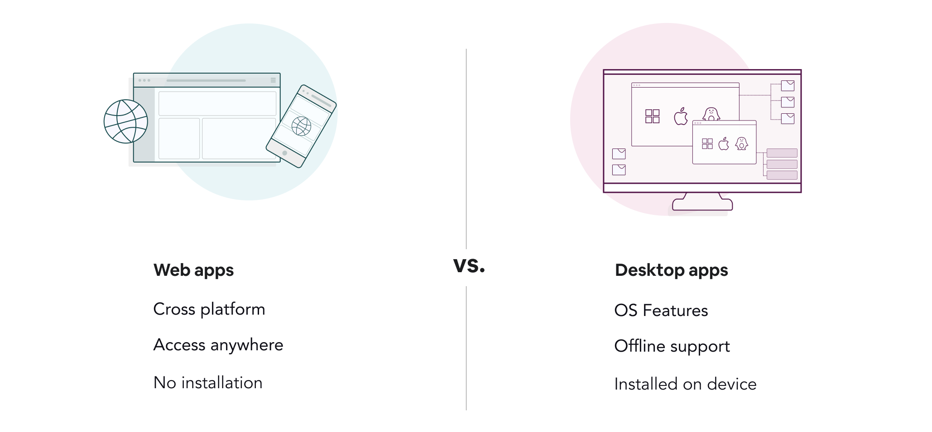
Web vs Desktop application

Slide 4
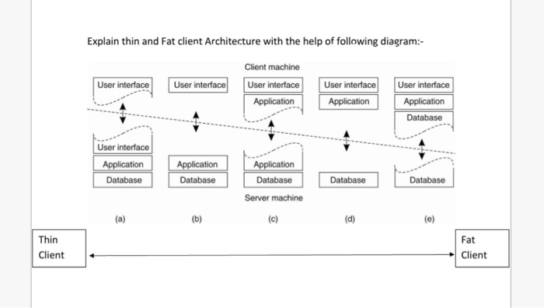
Thin and thick clients

Slide 5
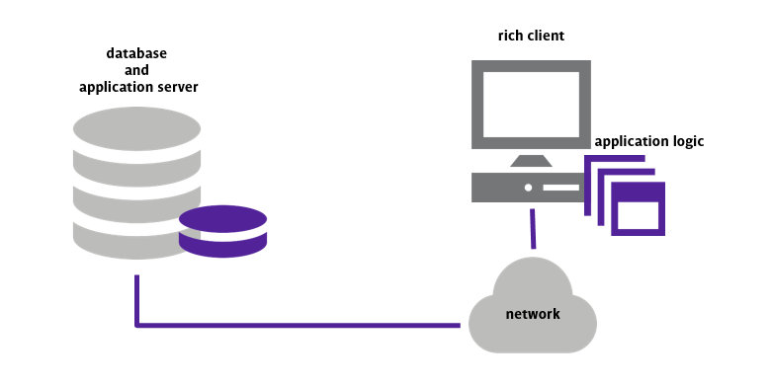
Rich client application

Slide 6

Tools for Desktop apps development

Slide 7
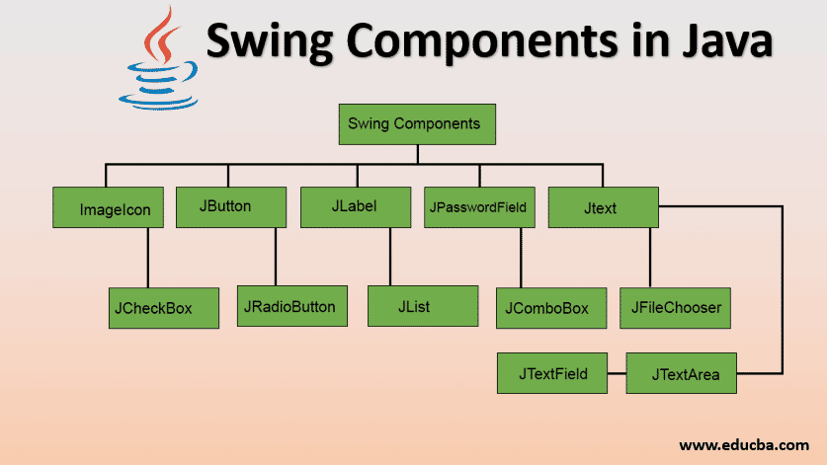
Java Swing

Slide 8
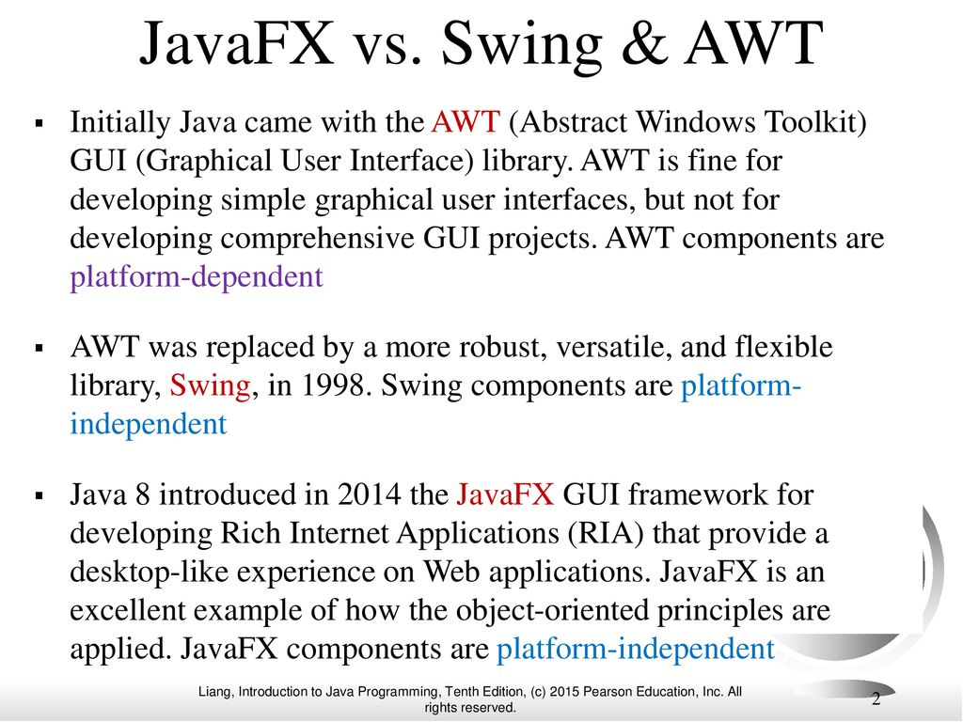

Slide 9
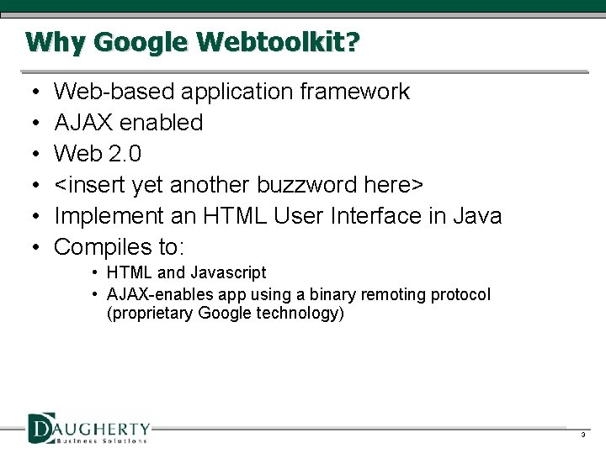
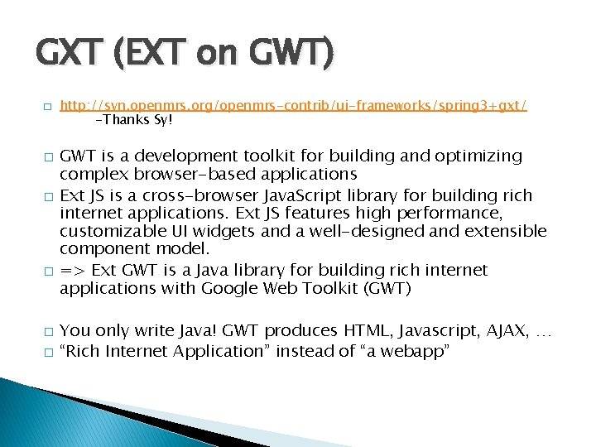
GWT/GXT

Slide 10
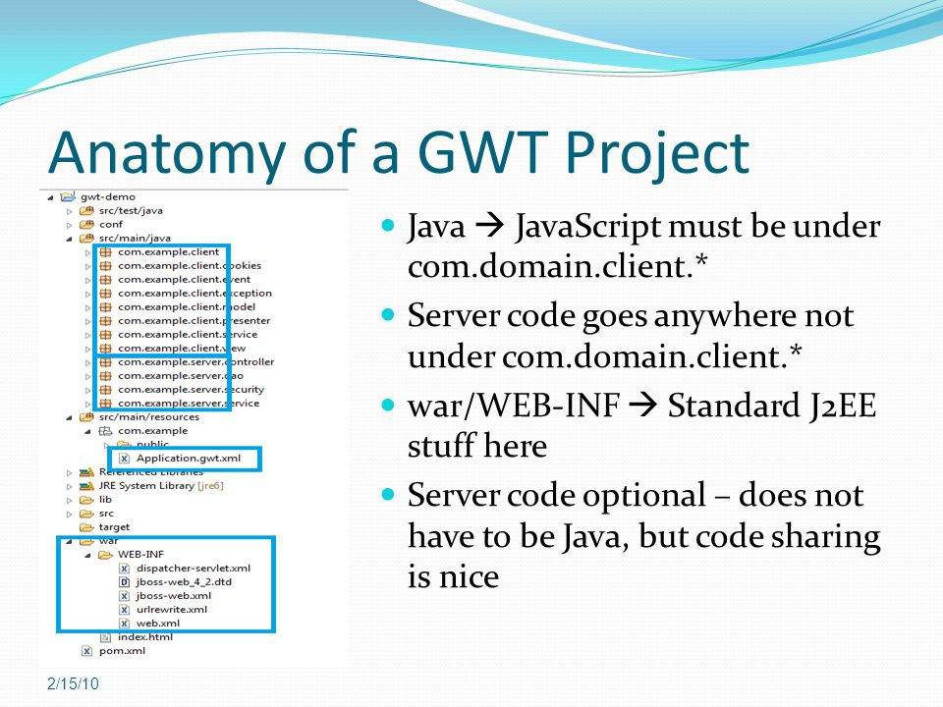
GWT project structure

Slide 11
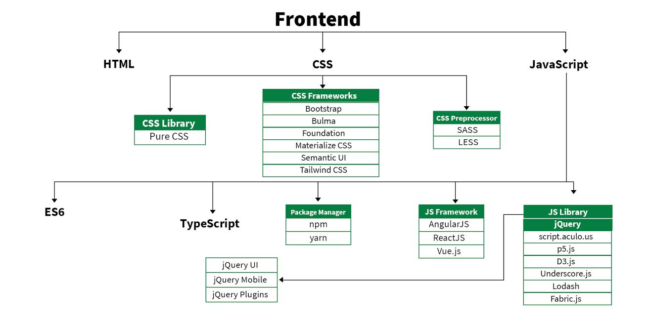
Web Frontend development

Slide 12
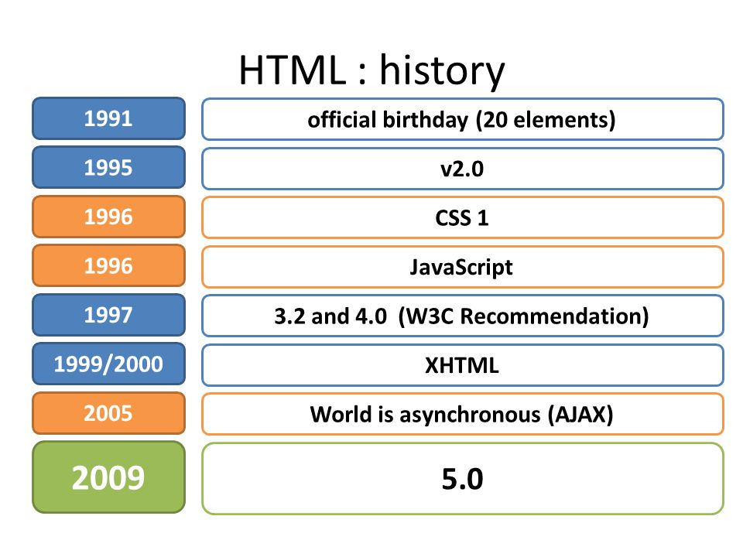
HTML history

Slide 13
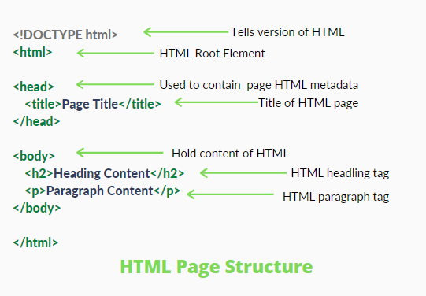
HTML page

Slide 14
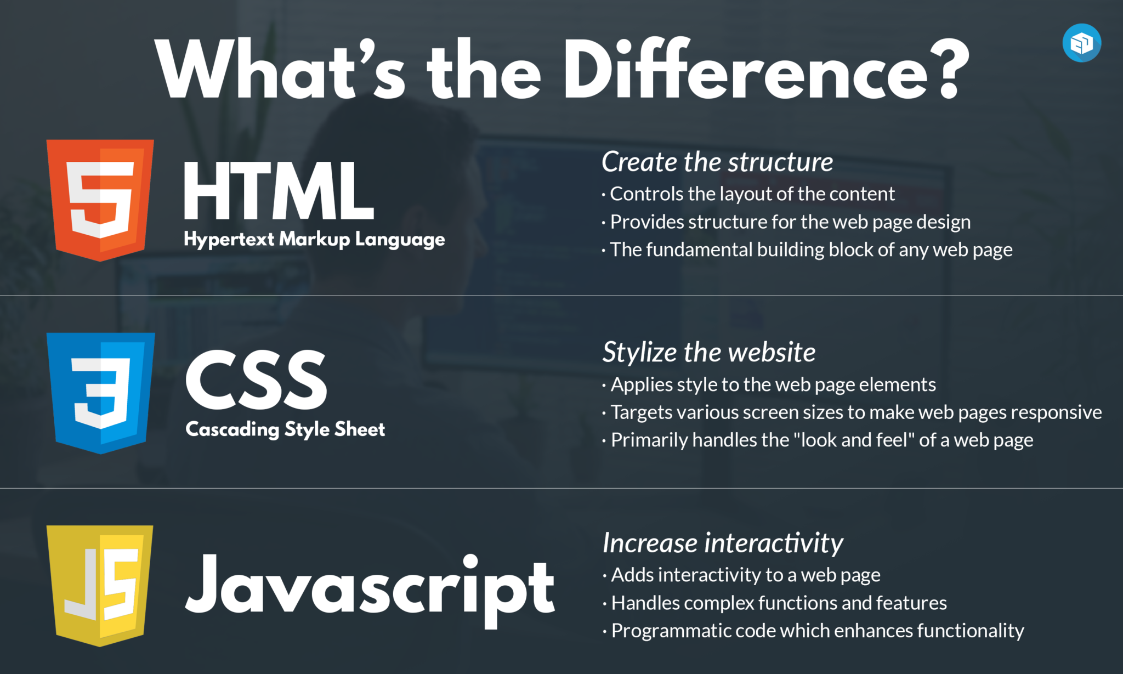
HTML and CSS

Slide 15
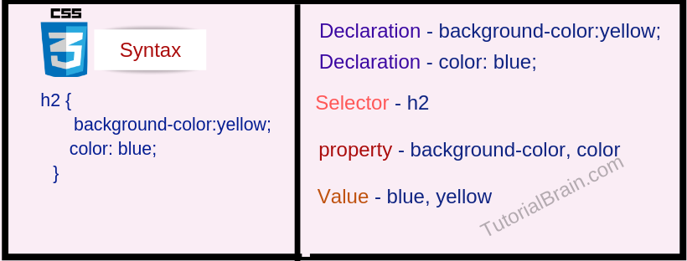
CSS syntax

Slide 16
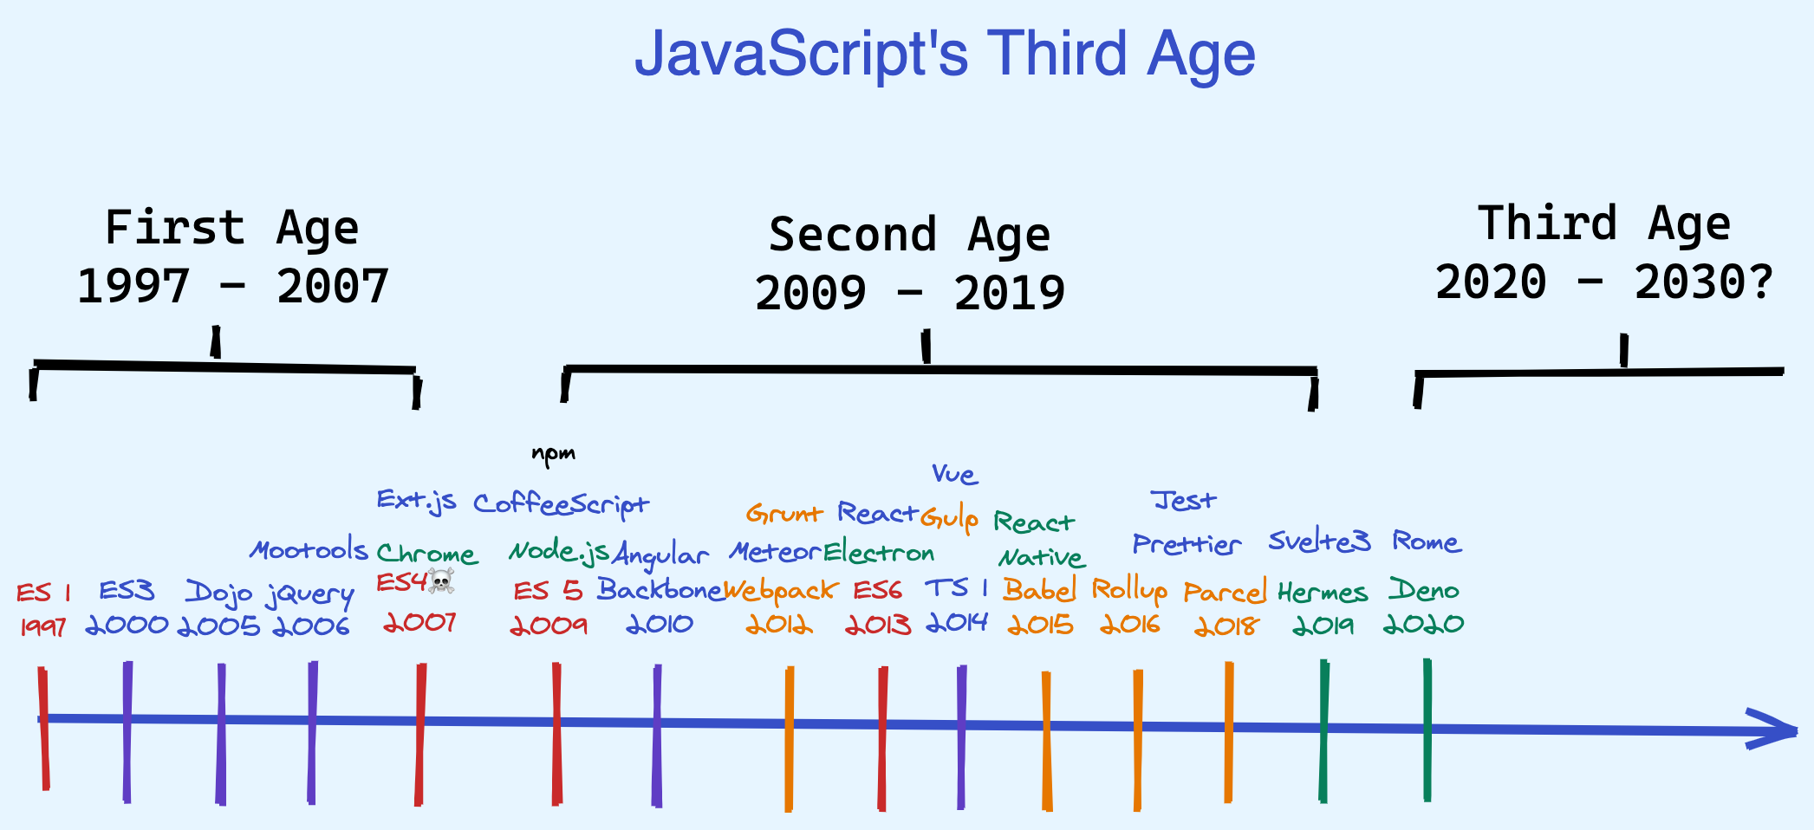
JavaScript history

Slide 17
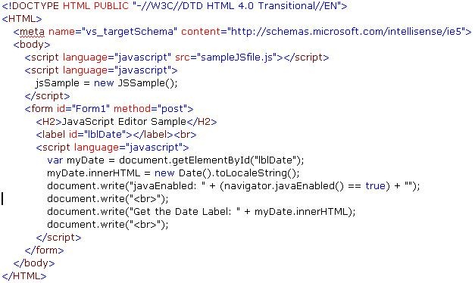
JavaScript example

Slide 18
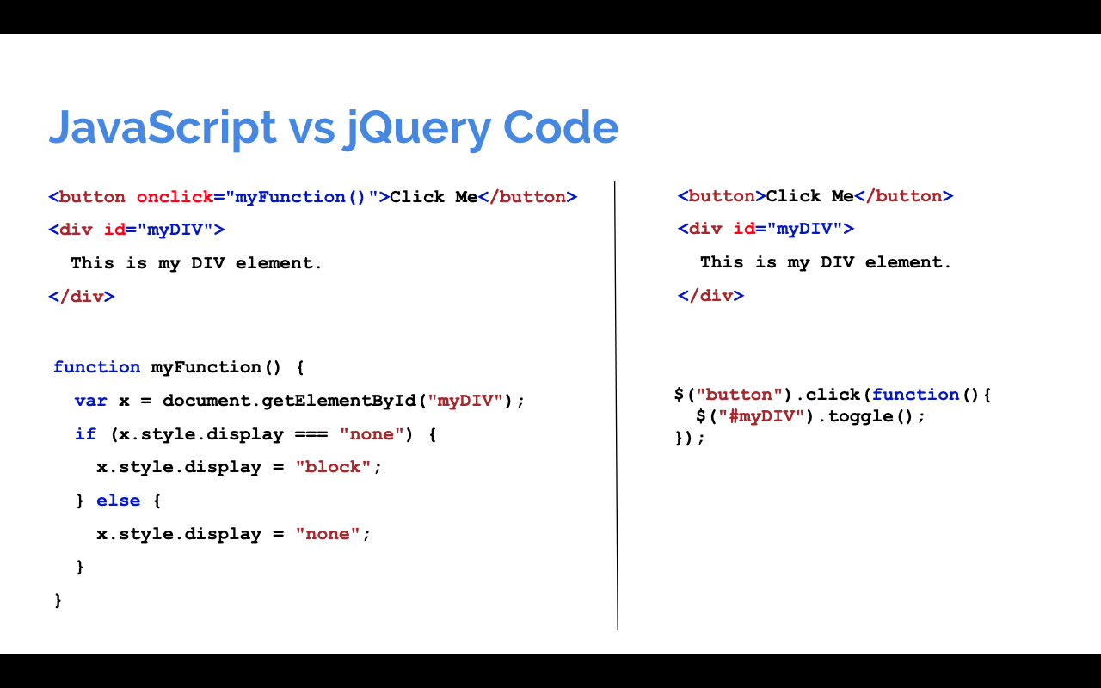
jQuery example

Slide 19
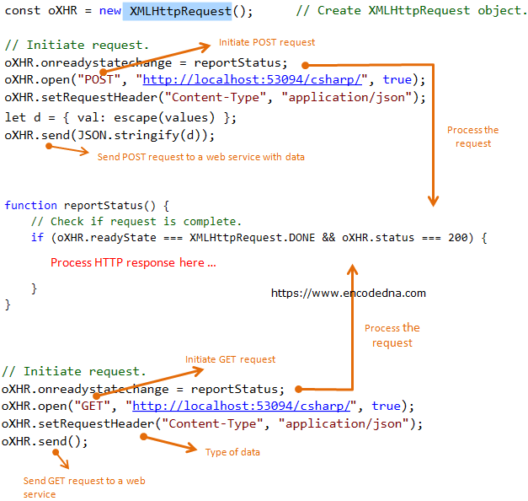
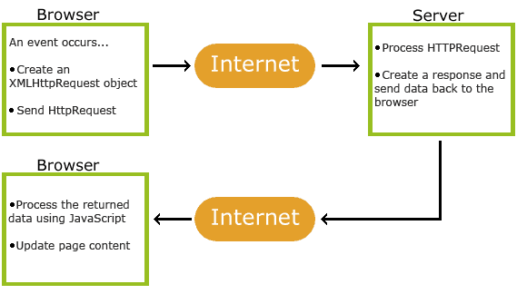
Ajax with JavaScript

Slide 20
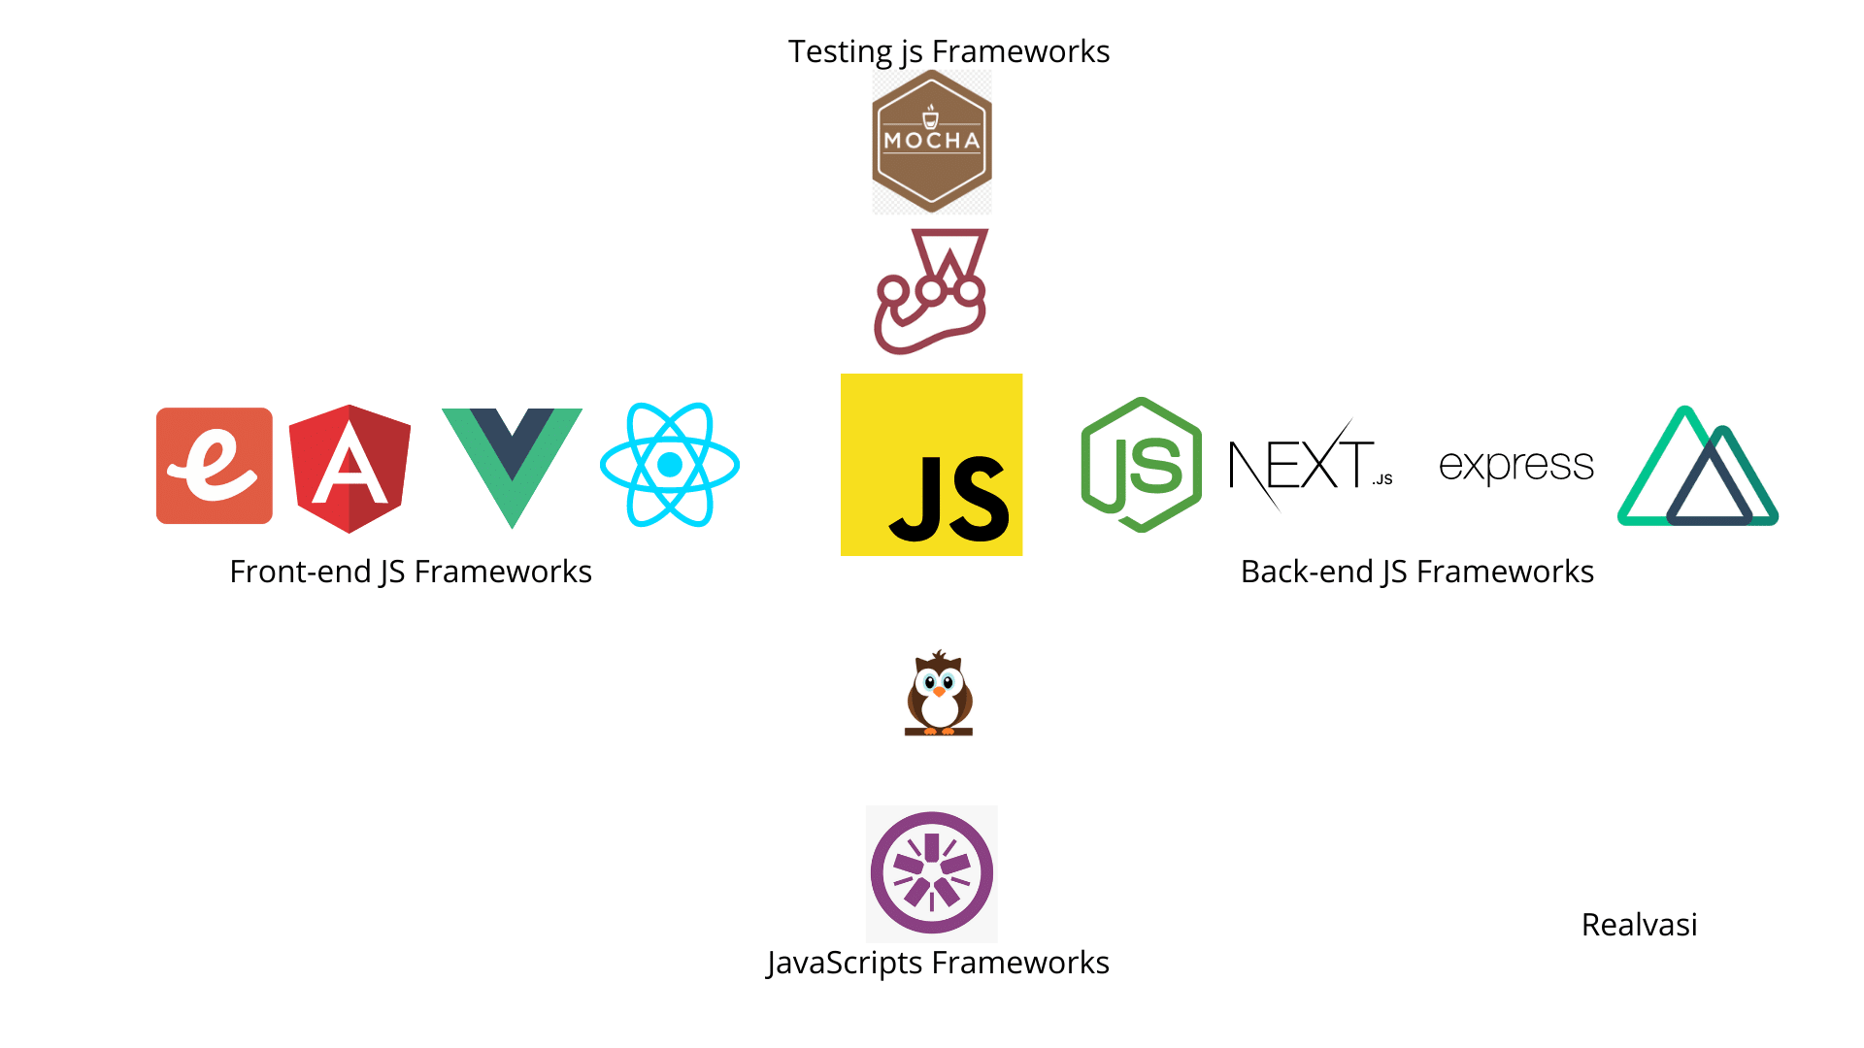
JavaScript frameworks

Slide 21
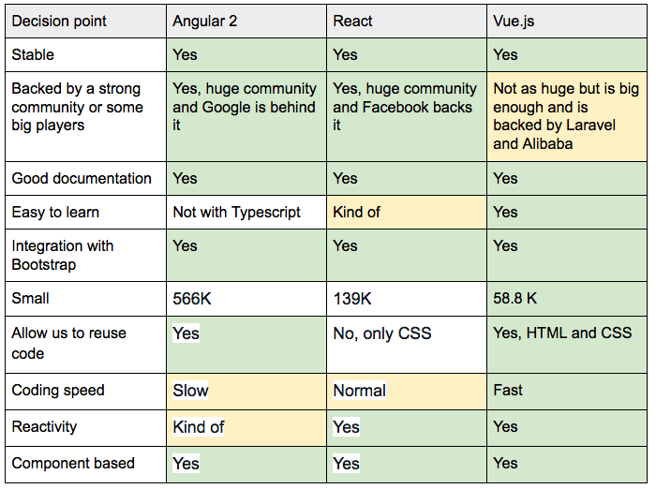
Angular vs React vs Vue

Slide 22
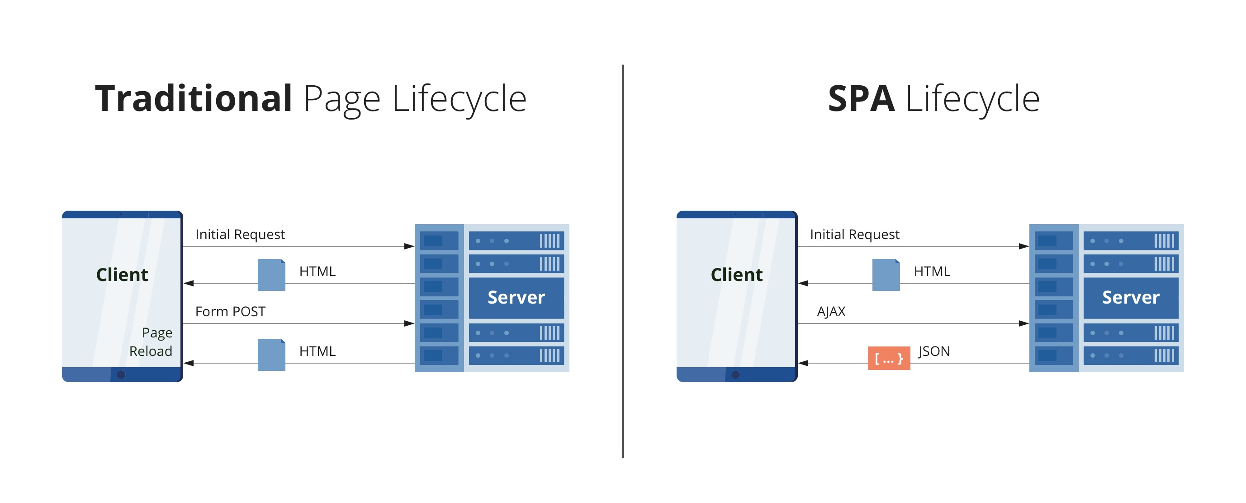
Single page application

Slide 23
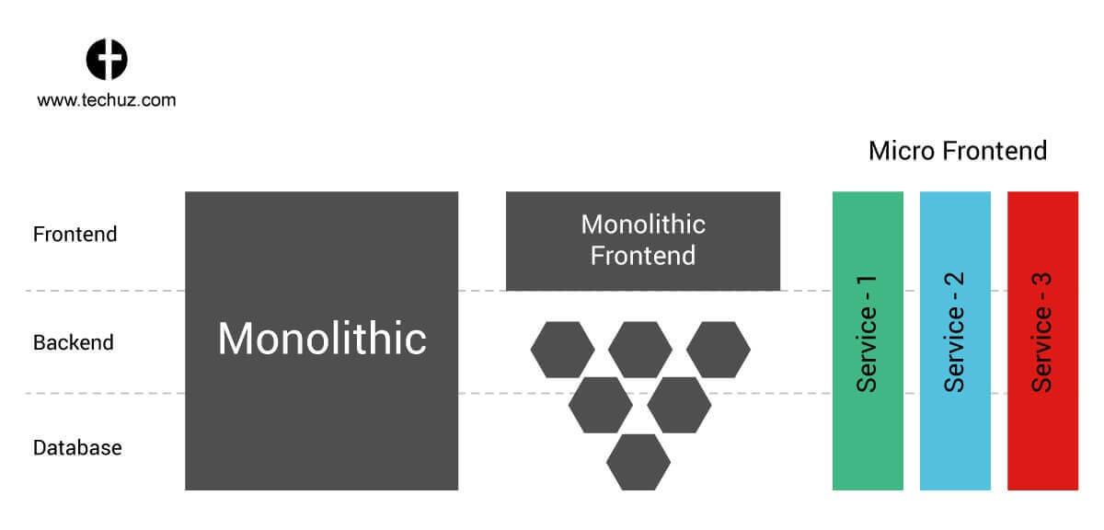
Architecture: micro frontends

Slide 24

SEO

Slide 25
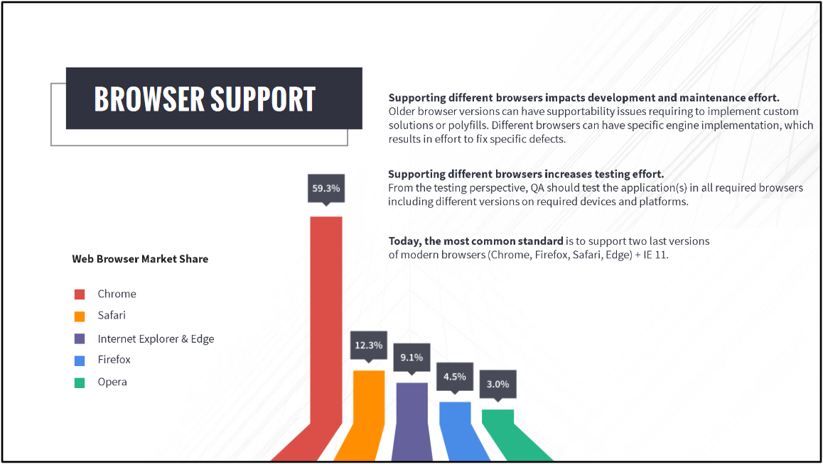

Slide 26
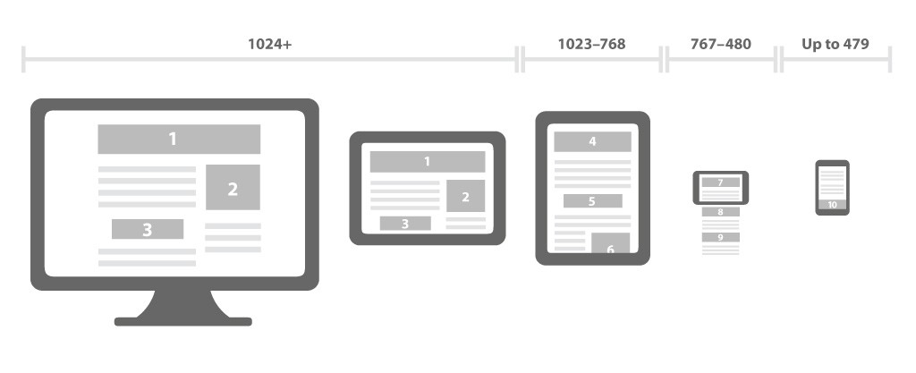
Responsive web design

Slide 27
Questions ?

